Slide 1

Python Programming
Frederick Li

Slide 2
Learning Objective
Start Python with “Hello world”
Using common data type (number/string/list/tuple/dictionary)
Flow control
Functions with parameters and returning values
Basic usage of packages and classes
Integrated example of web-scrapping and plotting data

Slide 3
Why Python
Easy to learn – Fewer code (in many cases) to accomplish tasks comparing with C++/Java…
Multi-purpose – Packages ranging from GUI application to machine learning
“You are not alone” – fastest growing programming language according to Stackoverflow Developer Survey 2018

Slide 4
Installation of Python
Python 3.6.8
Download the installation file of your platform (Windows/Mac/…) from https://www.python.org/downloads/release/python-368/
For Windows users, remember to check “Add Python to environment path”

Slide 5
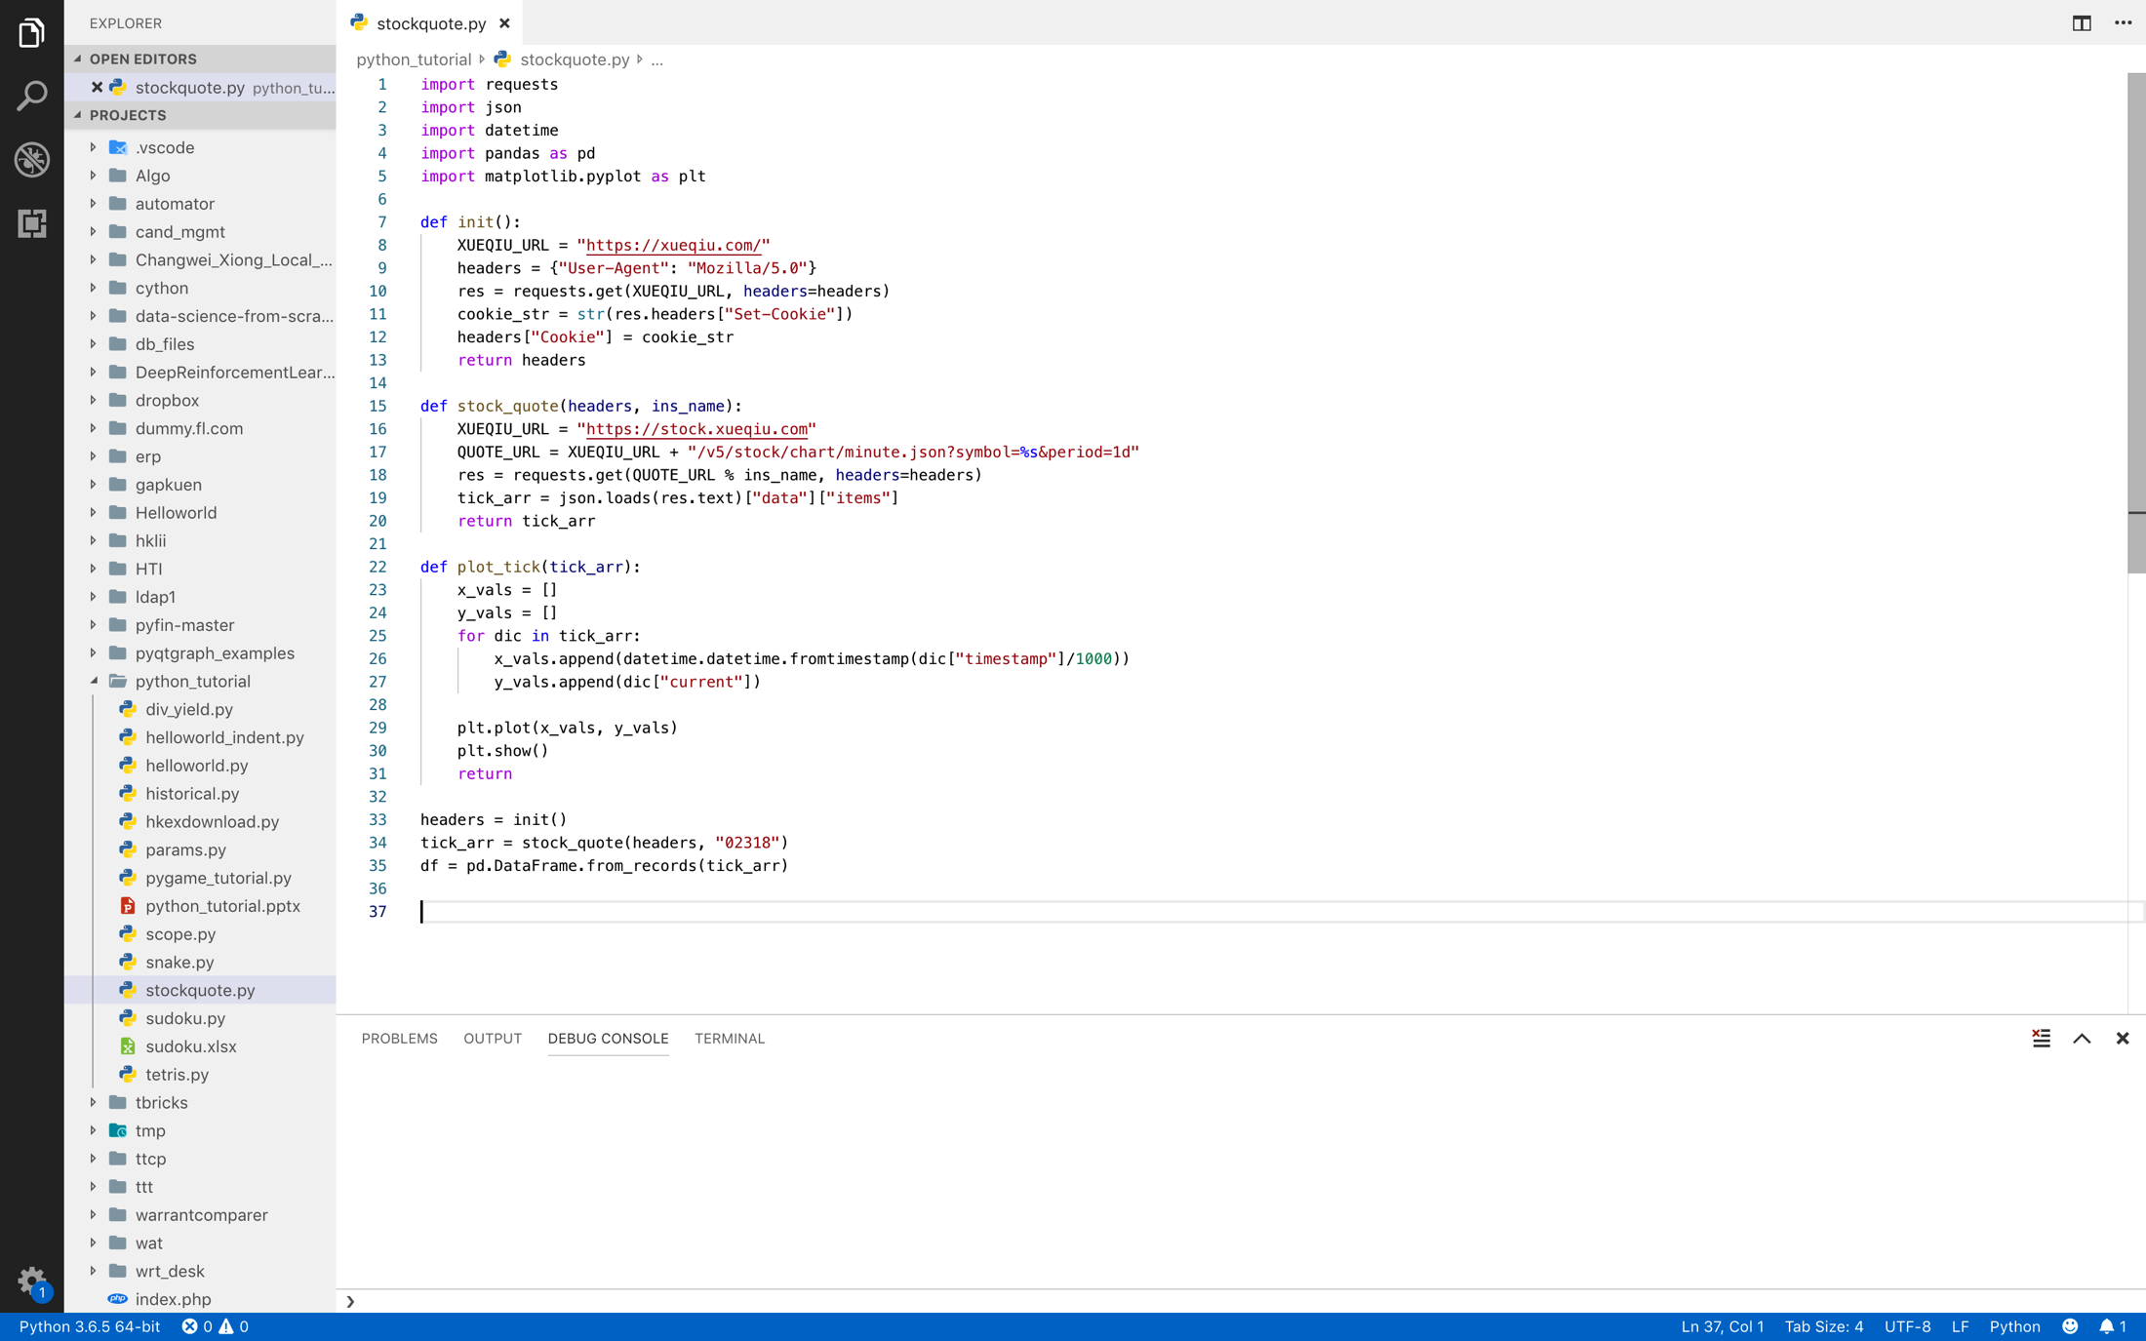
Installation of IDE (Integrated Development Environment)
You may use any text editor (Notepad++/Sublime Text/…) as your IDE
I use Visual Studio Code

Slide 6
Very Simple Program – Hello World
Start your IDE
Save as helloworld.py, .py is python script extension
Type the code in the following slide

Slide 7
helloworld.py
# Simple program (# indicates this is a comment line)
print(“Hello World”)

Slide 8
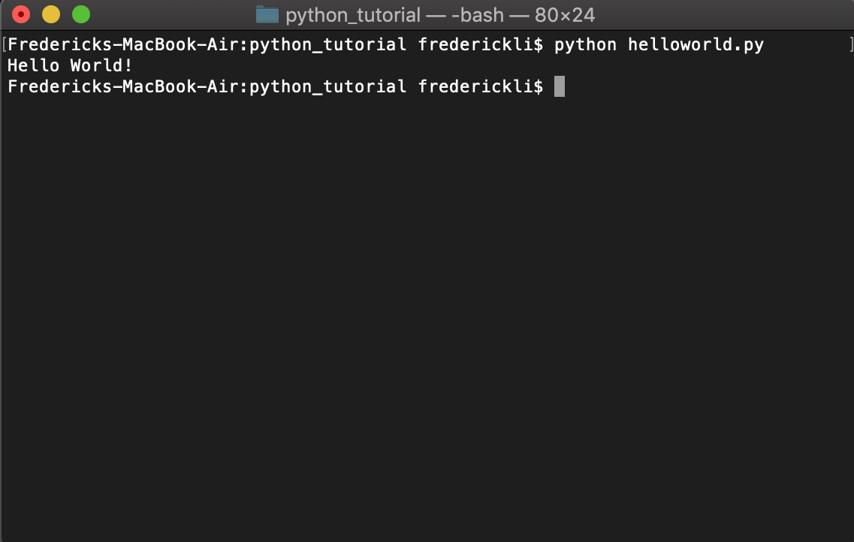
helloworld.py
To execute Python script
python helloworld.py

Slide 9
Data Type
Number
1
2e10
3.0
4j
String
“Hello”
Tuple
(1, 2, 3)
List
[1, 2, 3]
[[1, 2],
[3, 4]]
Dictionary
{“a”:1, “b”:2, “c”:3 }

Slide 10
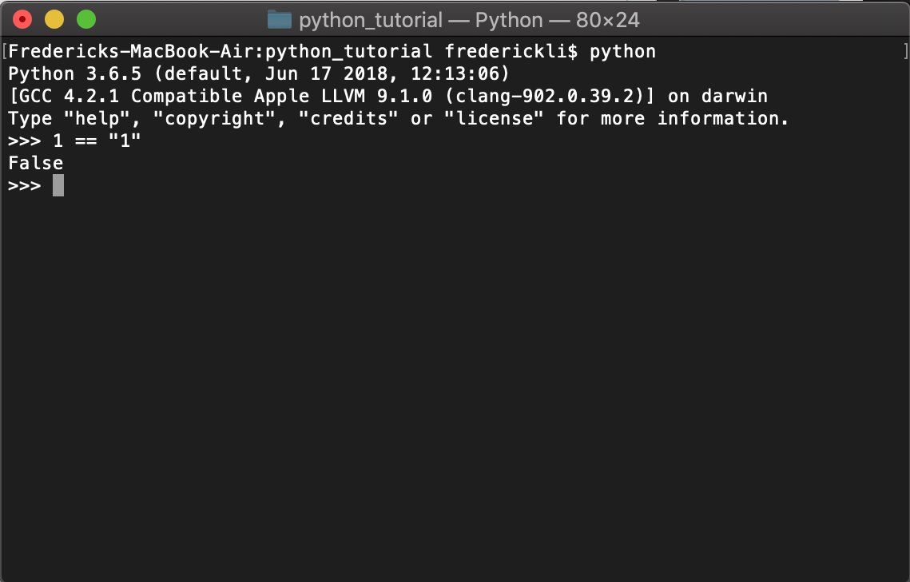
Data Type
1 == “1” ?
Type python in terminal
Type in line by line
Python string can be either single-quoted or double-quoted

Slide 11
Data Type
# Python is dynamically-typed, which means:
x = “hello”
print(x) # output: hello
x = 2.0
print(x) # output: 2.0
# without needs of casting

Slide 12
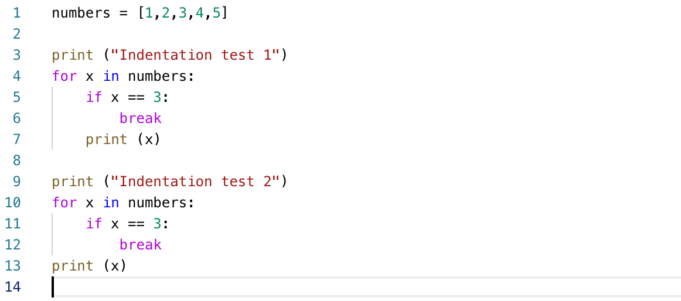
Indentation
What is the output?
A code block shared the same indentation
Imagine an indent level with colon is a pair of { }

Slide 13
Indentation
for x in numbers {
if x == 3 {
break
}
print (x)
}
for x in numbers {
if x == 3 {
break
}
}
print (x)

Slide 14
Code anatomy for x in numbers
“for” is one of the Python reserved words which means pre-defined function
“for” creates an iteration loop from the list (which is the numbers variable in this example) and does repetitious job
for s in [“apple”,”orange”,”pear”]:
print(s)
print(“apple”)
print(“orange”)
print(“pear”)

Slide 15
Code anatomy if x == 3
if (match a condition):
do_something()
elif (match another condition):
do_other_thing()
else:
do_something_else()

Slide 16
Code anatomy if x == 3
= is assignment operator, x = 3 # means assign 3 to x
== is match operator x == y # means if x matches y, return True if yes, otherwise False
!= is unmatch operator, which is opposite of ==

Slide 17
Code anatomy break / continue
To do further control of loop
Combination of for/if/… is called flow control of programming languages
for x in numbers:
if x == 3:
break
print (x)
# if x equals to 3, quit this loop
for x in numbers:
if x == 3:
continue
print (x)
# if x equals to 3, continue next x

Slide 18
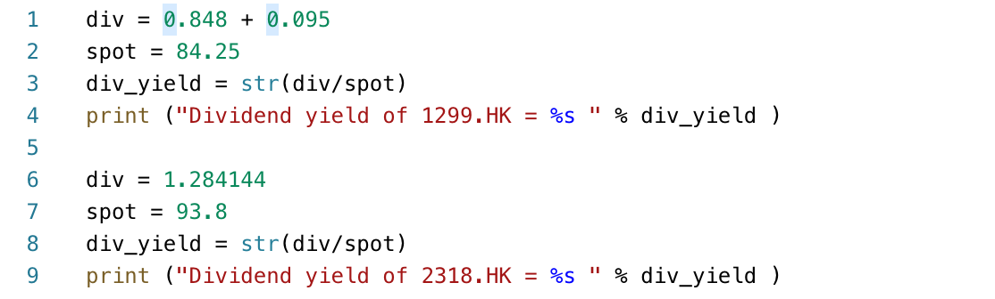
Function
Real life example, you want to calculate dividend yield for some stocks:
% notation means substitution of string

Slide 19
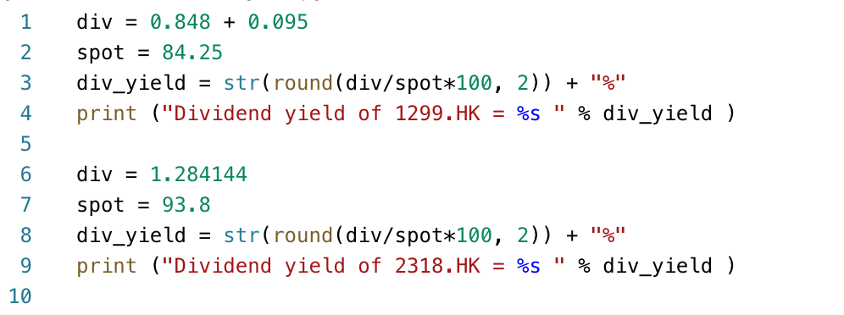
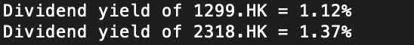
Function
If we want to show dividend yield in percentage with 2 decimal places:

Slide 20
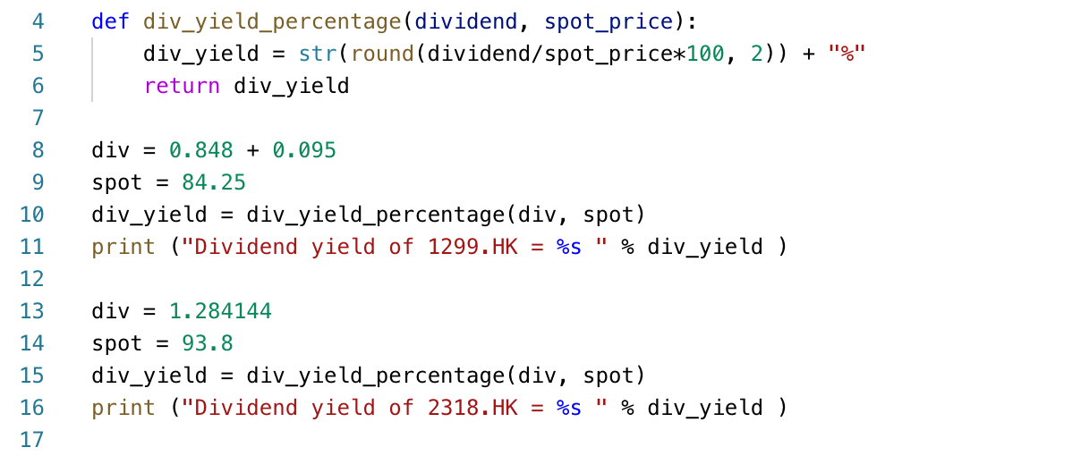
Function
If we have tens or even more stocks, we want to have a efficient and consistent way to show dividend

Slide 21
Function
# def indicates the start of function scope
def function_name(input_1, input_2, input_3, …):
statement_1
statement_2
...
return output_1, output_2, output_3, …
# To use this function
output_1, output_2, output_3 = function_name(input_1, input_2, input_3)

Slide 22
Function
In the example, str() and round() are Python built-in function
str(object) returns a string representation of data types or objects
round(number, digits) takes two inputs, and return a number rounded with certain digits
You may cascade function input and output together for many usages.

Slide 23
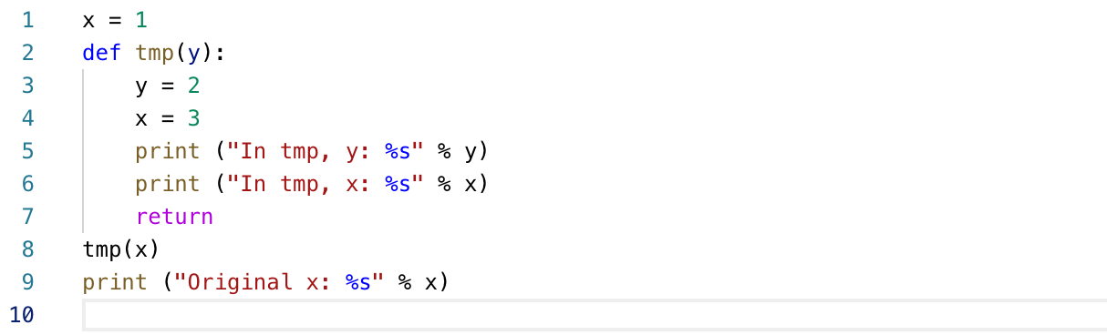
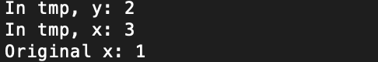
Scope
Why the output is like this?

Slide 24
Scope
At line 1, x = 1
From line 2 to 7, it is in function scope, the program will skip these lines at the time being
At line 8, it calls the function tmp with parameter x which is 1, the program continues executing inside function tmp
At line 3, the program change the value of input (1) to 2
At line 4, it generates another x of value 3
At line 5 and 6, the program prints the current value of y and x
At line 7, the function returns nothing and exits, local change of values inside function will not affect others outside the function (scope)
At line 8, as x is actually unchanged after the function, so the output x is now 1

Slide 25
Scope
If local change within a function scope cannot be brought outside, what should we do if we want to change values by function?
Use “return” to return value processed by function
def tmp(y):
…
return y
x = tmp(x)
Use “global” keyword inside function (NOT recommended)

Slide 26
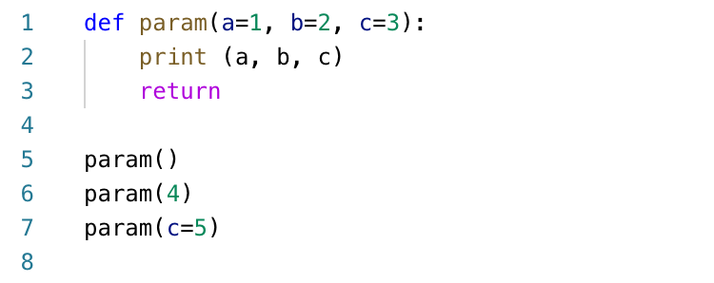
Default parameter
What is the output?
Python supports default parameters (arguments)
Simply assign value in the parameters input fields in function header

Slide 27
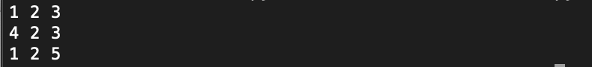
Default parameter
The first param() without any input, so a=1, b=2, c=3 as assigned by default
The second param() has 4 as input, the parameter input will be arranged sequentially, i.e. first parameter of input will be fed to first parameter in header, override default values, while other preserved defaults
The third param() explicitly assign value to a certain parameter

Slide 28
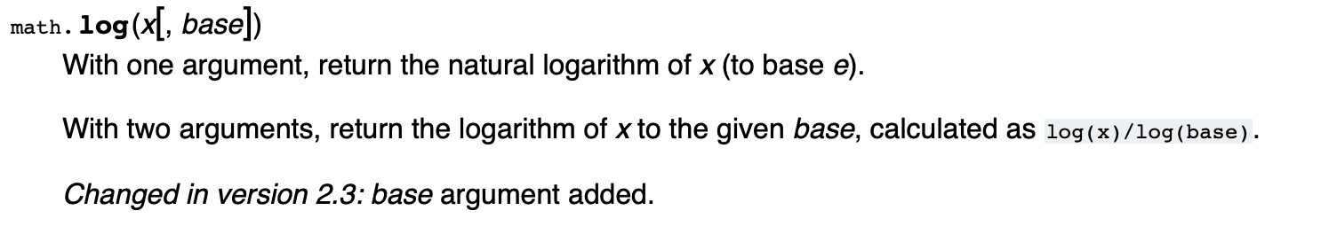
Default parameter
The required parameter and default parameter mixed pattern is useful for defining complicated function
Taking Python math.log function as example, you can input or skip base, which the default base is e, otherwise you may use log(x, 10) as base 10

Slide 29
Package
One of the most versatile capabilities of Python (to me) is the import of packages, no need to reinvent the wheel!
Python built-in package example
os
re
math
datetime
multiprocessing
…
3rd party package example
numpy
pandas
scipy
matplotlib
tensorflow
…

Slide 30
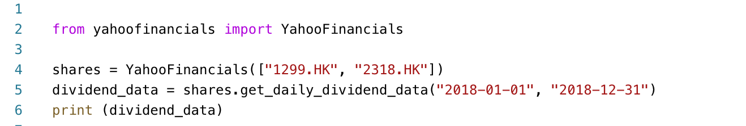
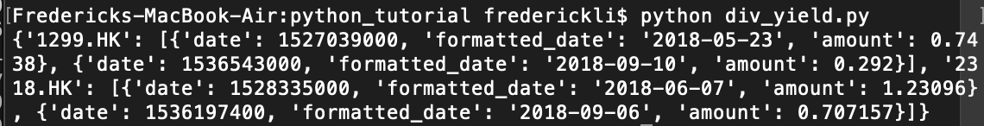
Package
In command prompt, type:
>> pip install yahoofinancials
Then run the following program:

Slide 31
Code anatomy from yahoofinancials import YahooFinancials
Different packages have different “import preference”, e.g.
import request
import win32com.client
import pandas as pd
from yahoofinancials import YahooFinancials
Rule of Thumb: Read the manual of the package!
https://pypi.org/project/yahoofinancials/

Slide 32
Code anatomy shares = YahooFinancials([ … ])
YahooFinancials is a class, but what is class?
You may think class is a Python object which consists of attributes (variables) and methods (functions)
You may feed parameters to initialize a class, similar to functions, depends on the design of the class
Again, read the manual before you proceed

Slide 33
Code anatomy shares = YahooFinancials([ … ])
Once you initialize a Python class, left hand side of this expression will be the corresponding class object
The object “contains” the attributes and methods of the class
To use the class attributes and methods, use a . (dot) to access, e.g.
class_object.attribute
class_object.method()

Slide 34
Code anatomy data = shares.get_daily_dividend_data(…, …)
There are many methods provided by YahooFinancials class, which gives different financial data such as historical OHLC (Open/High/Low/Close), dividend, earning, etc.
In our tutorial, we want to get yearly dividend of 2018 as benchmark dividend of 2019

Slide 35
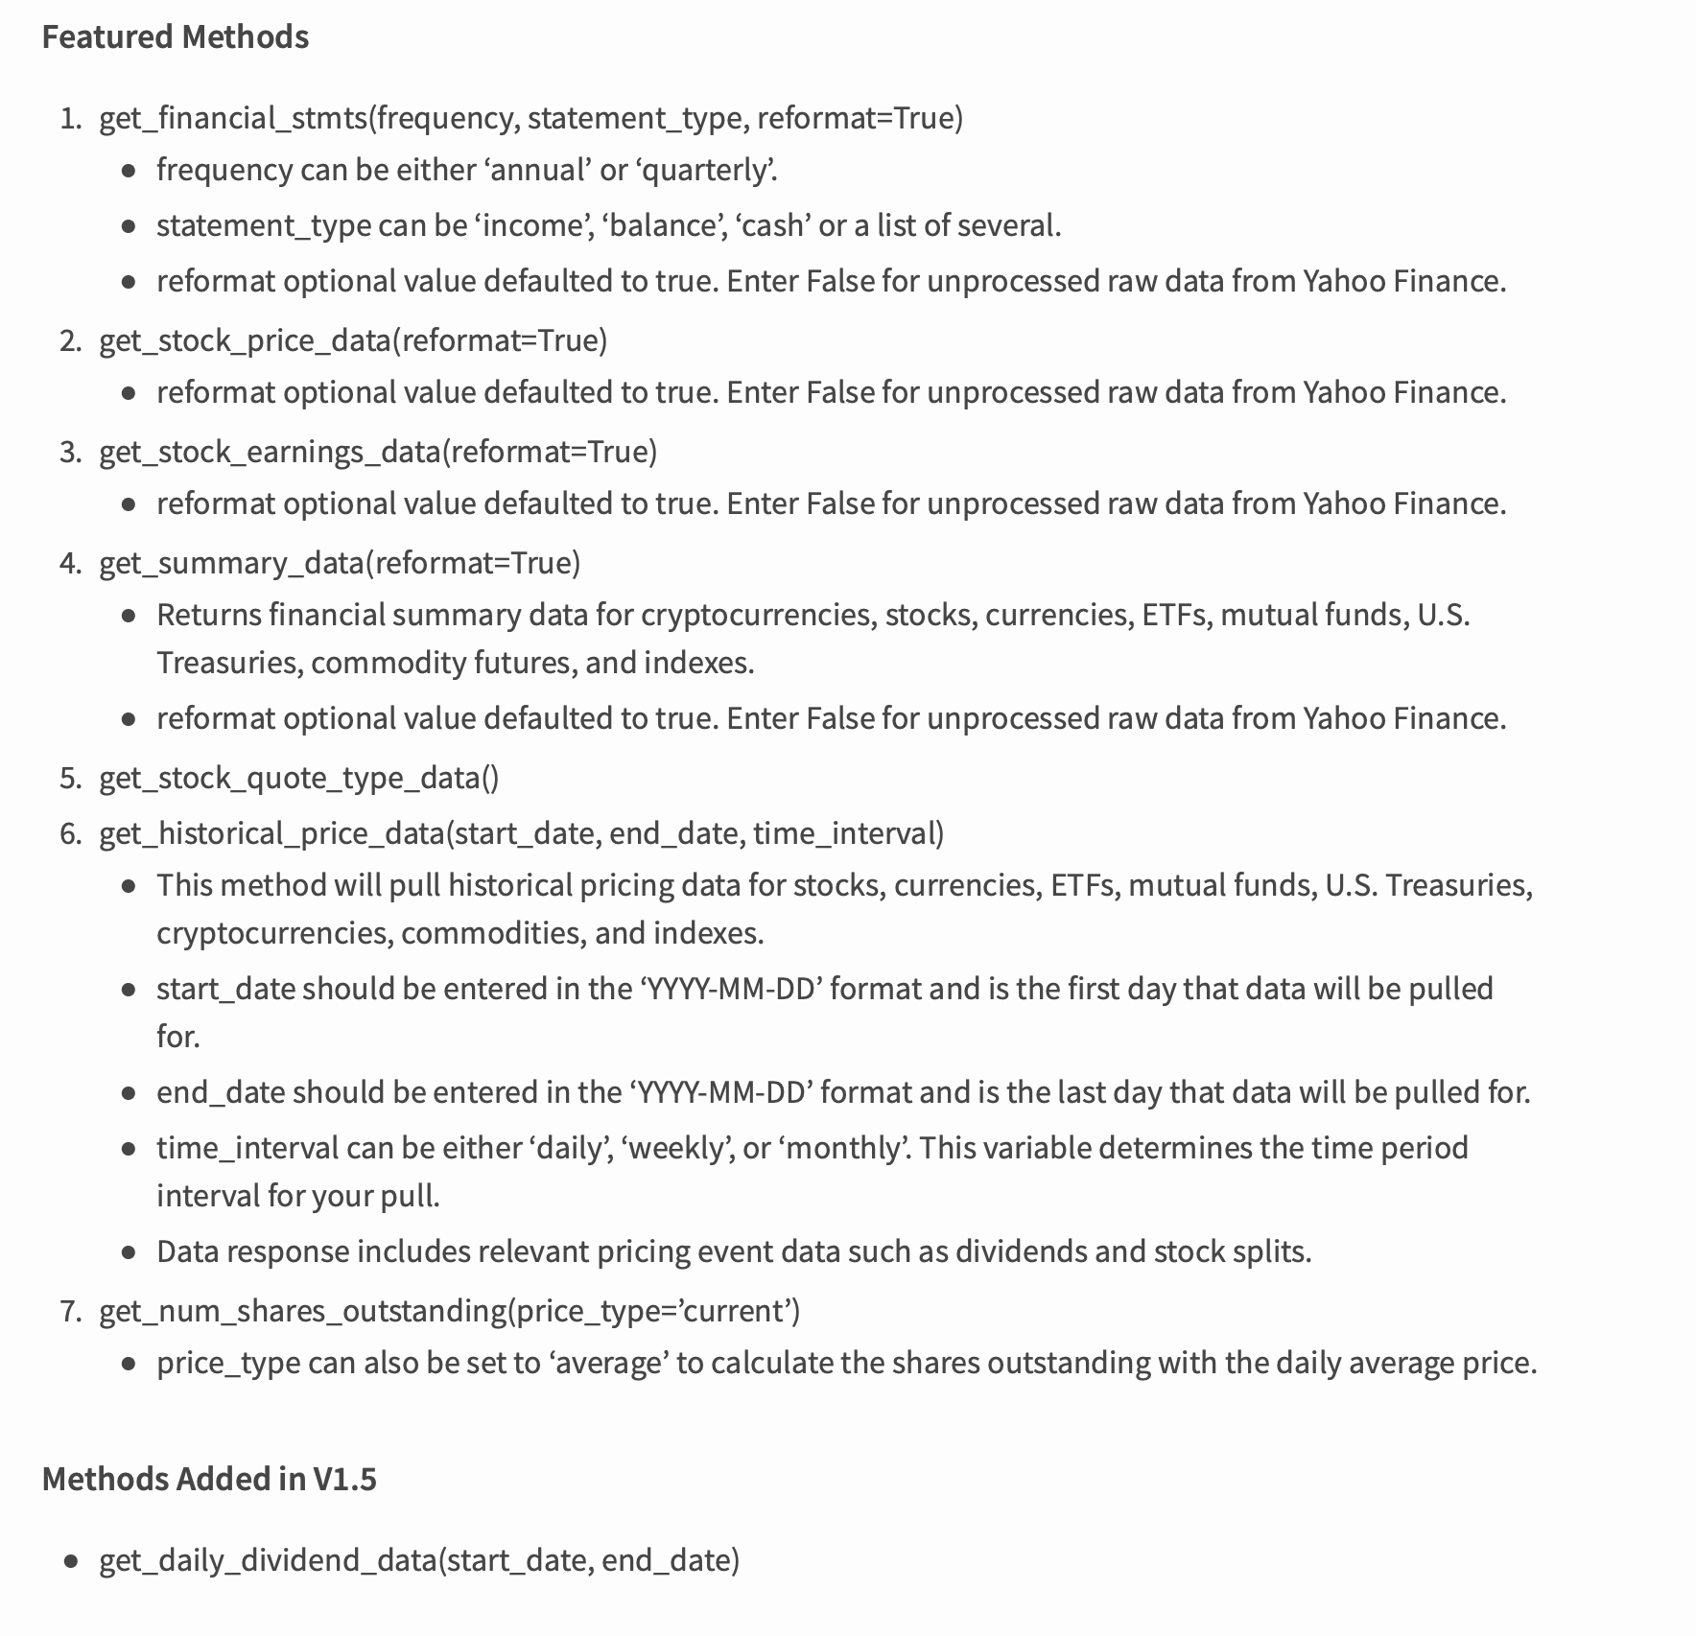

Slide 36
Output
{'1299.HK': [{'date': 1527039000, 'formatted_date': '2018-05-23', 'amount': 0.7438}, {'date': 1536543000, 'formatted_date': '2018-09-10', 'amount': 0.292}], '2318.HK': [{'date': 1528335000, 'formatted_date': '2018-06-07', 'amount': 1.23096}, {'date': 1536197400, 'formatted_date': '2018-09-06', 'amount': 0.707157}]}
What is this?

Slide 37
Output
{
‘1299.HK’: [
{
'date':1527039000,
'formatted_date':'2018-05-23',
'amount':0.7438,
},
{
‘date’:1536543000,
…
}
],
‘2318.HK’ : [
…
]
}

Slide 38
Output
The data consists of multi-layers of dictionary and list
1st level is a dictionary with RIC (Reuters Instrument Code) as key
2nd level is an array of different dividend by ex-date
3rd level is a dictionary of information of a dividend

Slide 39
Data Type Revisit (list)
List is a sequence of numbers/strings/objects, to declare:
num_arr = [95.8, 365.5, 11.2]
str_arr = [‘2318.HK’,’0700.HK’,’778.HK’]
arr_2d = [[1, 2], [3, 4]]
To access the value within list, simply use [index_of_value], list index starts from 0 which means first element of list is of index 0
print (num_arr[0]) # will show 95.8
print (arr_2d[1]) # will show [3, 4]
To change value of list, simply assign new value to it, i.e.
str_arr[2] = “0175.HK” # str_arr becomes [‘2318.HK’,’0700.HK’,’0175.HK’]

Slide 40
Data Type Revisit (tuple)
Tuple is similar to list except tuple is immutable (i.e. cannot modify its values after declaration), i.e.
t = (1, 2, 3)
t[0] = 4 # assign value will cause ERROR!

Slide 41
Data Type Revisit (dictionary)
Dictionary is a “container” to store key-value pairs, i.e.
stat_dict = {“.HSI”:28500, “2318.HK”:95.8, “0700.HK”:360.5}
To access the value in dictionary by specifying the key:
print (stat_dict[“0700.HK”]) # will show 360.5
To modify the value in dictionary by assign new value of certain key:
stat_dict[“.HSI”] = 28880

Slide 42
Data Type Revisit (dictionary)
Common dictionary built-in method:
stat_dict .keys() # return [“.HSI”, “2318.HK”, “0700.HK”]
stat_dict.values() # return [28500, 95.8, 360.5]
stat_dict.items() # return [(“.HSI”, 28500), (“2318.HK”,95.8), (“0700.HK”,360.5)]

Slide 43
Dividend yield by YahooFinancials data
Use .items() to iterate the dictionary to get dividend payments by each instrument
Prepare a variable total dividend with initial value of 0 to store the sum of dividends
Iterate dividend from the payments
Get each dividend ex-date and amount, sum the amount to total dividend

Slide 44
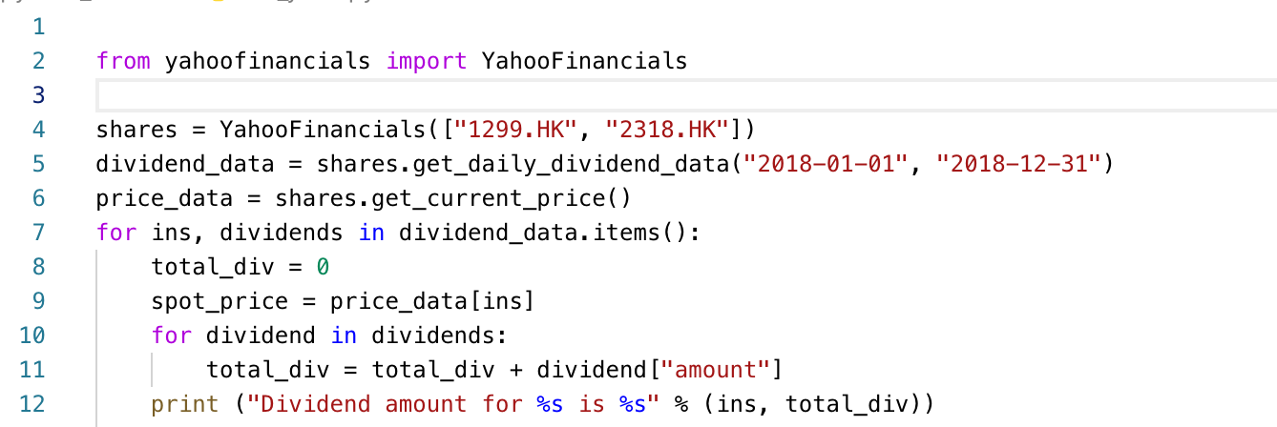
Dividend amount by YahooFinancials data

Slide 45
Dividend yield by YahooFinancials data
Deduce dividend yield from dividend amount is easy, simply divide it by stock price
Recall the previous slide, we have current spot price

Slide 46
Write your own stock quote class
One weakness of the YahooFinancials class is it lacks the intra-day data
Xueqiu (雪球) provides minute quote data

Slide 47
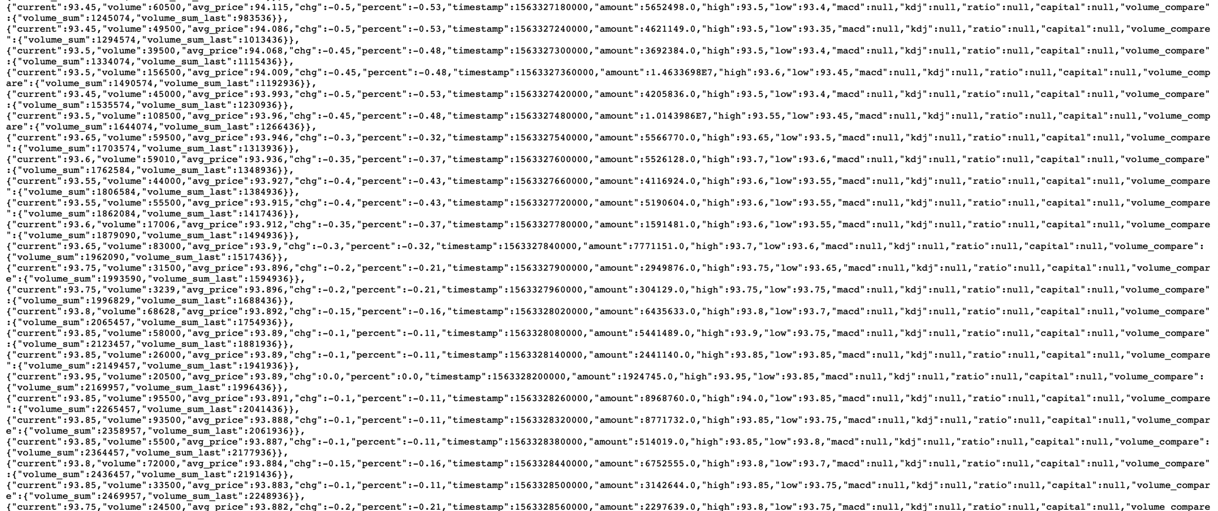
Xueqiu minute quote
If you access the minute quote url
https://stock.xueqiu.com/v5/stock/chart/minute.json?symbol=02318&period=1d

Slide 48
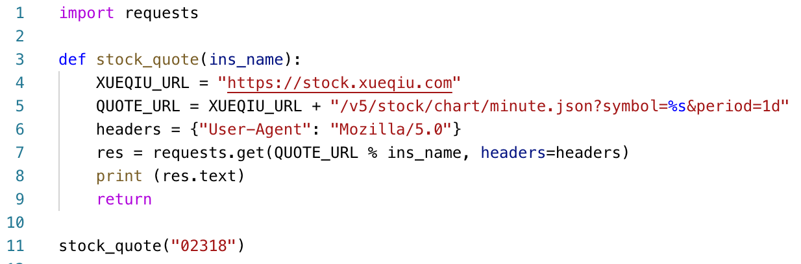
Python requests library
Oops!

Slide 49
Python requests library
As we have quote url in previous slide, we need to substitute the symbol=XXXXX with desired stock code
The headers dictionary contains a HTTP header to emulate browser HTTP request, as many website block HTTP request without headers
requests.get is a HTTP GET request (technical details for HTTP skipped), you may think most read access to ordinary website is a HTTP GET
So we have the code:
res = requests.get(QUOTE_URL % ins_name, headers=headers)

Slide 50
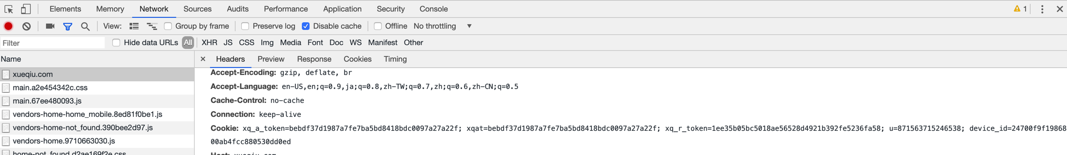
Python requests library
The HTTP request is rejected by xueqiu, as we do not have its cookies, so it prevents direct access to its resources
Use Google Chrome or other browser, Use F12 or right click->inspect element to view the HTTP request
Focus on the cookies part

Slide 51
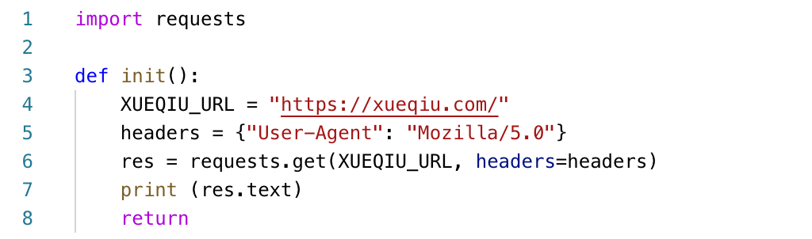
Python requests library
The response object returned by requests.get contains many attribute, one of them is headers, which most likely contains cookies we need

Slide 52
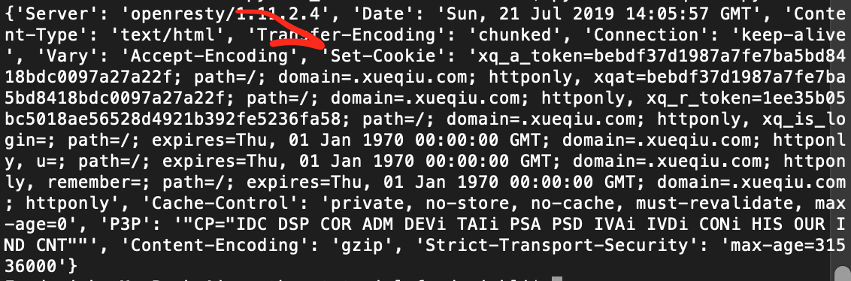
Python requests library
The headers is actually a dictionary object
Focus on the Set-Cookie part, which is exactly the cookie part of the HTTP request in previous slide

Slide 53
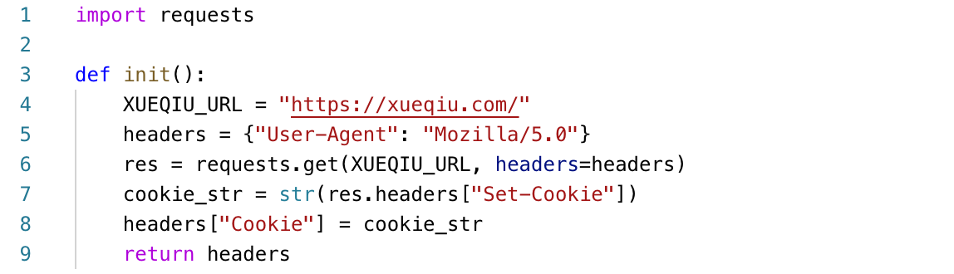
Python requests library
So after first connection, we get a cookie for later connections, then combine this cookie into original header:

Slide 54
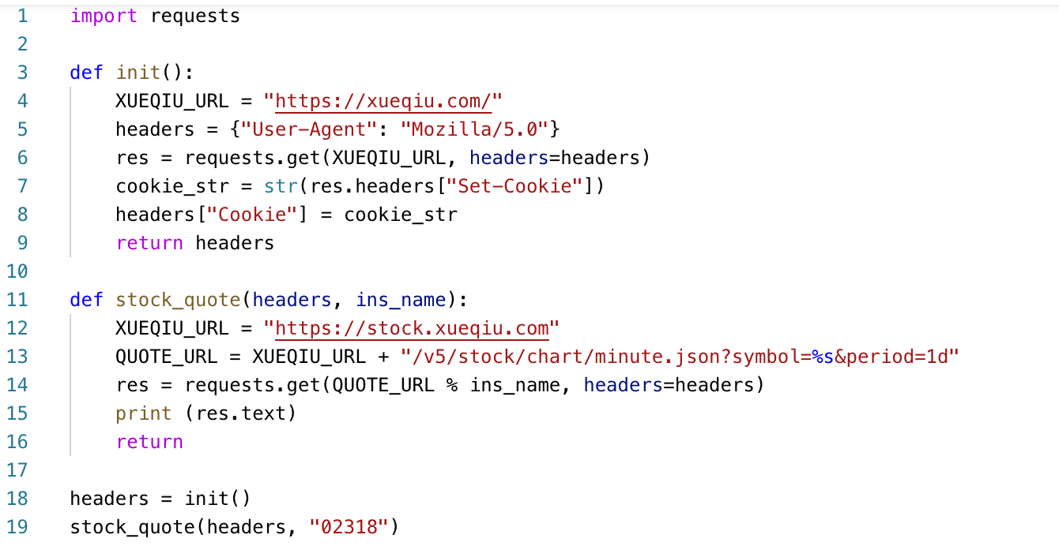
Python requests library
Combine with the stock_quote function with new headers as parameter:

Slide 55
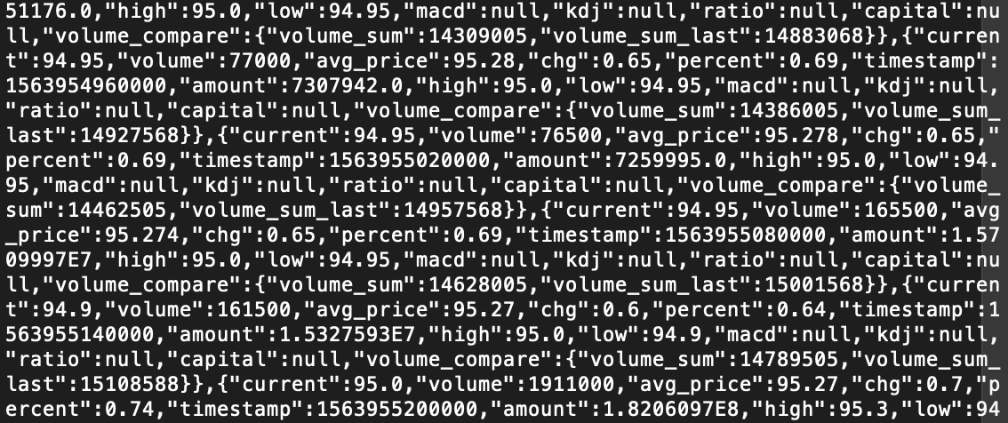
Python requests library

Slide 56
JSON format
The dictionary shown in previous slide is in JSON format
Encode the information in JSON to allow easy access to tick data (stock price data across different time)
Using Python JSON library can easily turn the data into aggregation of dictionary and array as shown in dividend example
Or we can use a very powerful tool – Pandas to process the data

Slide 57
Pandas
One of the most versatile libraries in Python
Turn 2D list or higher dimension matrix into “Dataframe” data structure
Allow easy row, column or other data manipulation to the data
pip install pandas
import pandas as pd

Slide 58
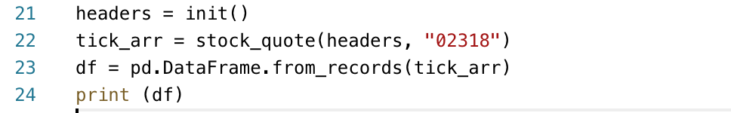
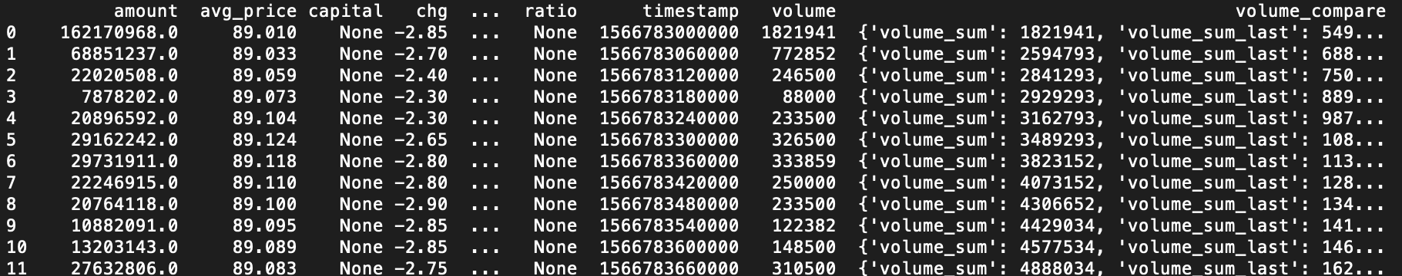
Convert dataset to Panda Dataframe
For array of dictionary, we can use pd.Dataframe.from_records() to convert dataset to dataframe

Slide 59
Dataframe Basic
To access column of the dataframe: df[“timestamp”]
To access the first row of the dataframe: df.iloc[0]
To get dataframe matching certain criteria: df.loc[df[“timestamp”] >= x]
Apply arithmetic operation to column: df[“mean”] = (df[“high”] + df[“low”])/2
Drop unwanted columns: df = df.drop(columns=[“capitial”, “kdj”, “ratio”, “volume_compare”])

Slide 60
Parse timestamp
The timestamp is in numbers like 1564127940000
This resembles with the unix-like timestamp (number of seconds from 1970-01-01), but this one has three more trailling zeros at the end
Simply divide the number by 1000 to convert this to Python datetime by datetime.datetime.fromtimestamp() method

Slide 61
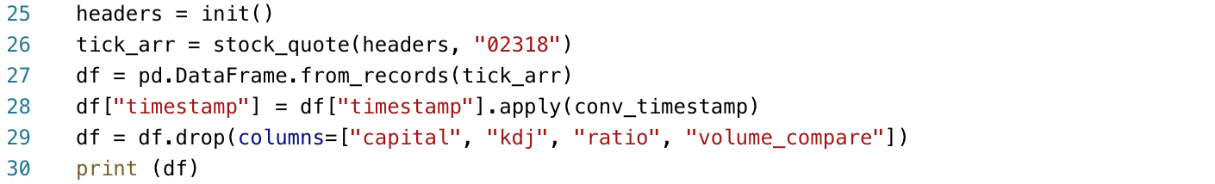
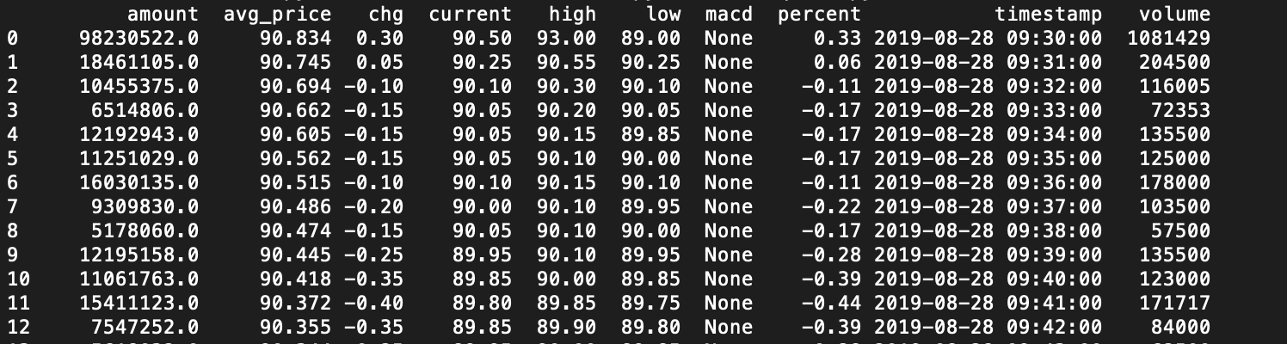
Apply function to column
“Batch update” the whole column by applying function to a column

Slide 62
Technical Analysis
We will use ta (technical analysis) library
Contains RSI, Bollinger Band, etc.
pip install ta
import ta

Slide 63
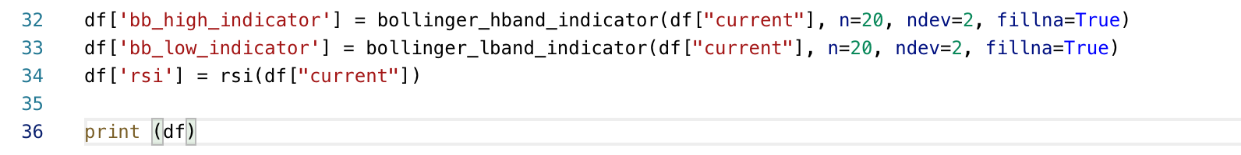
Technical Analysis
Let’s formulate a strategy which using Bollinger Band and RSI as indicator
Using the function which ta library provide:

